Slide 1
Intro to Containers

Slide 2
A long time ago...
Got an application that you need to scale rapidly? Better head down to your local computer store to buy more servers
Want your application to run on these newly acquired servers without fuss? Better install the same OS and be sure to match up version numbers
Want a developer to run a local copy on their work machine? Spend the next few hours troubleshooting with them on why the same application runs fine on your machine but not on theirs.
Trade Off between convenience, cost and security: either you run multiple applications on the same server, or you spend a lot of money for individual servers for each application.
Big problem: Got a lot servers not nearly at capacity until they are which wastes lots of money and space

Slide 3
Introducing Virtual Machines!
A virtual machine is just a guest operating system that runs on top of a host operating system. That host system is often referred to as a hypervisor.
Cool CPU instructions such as VT-x and AMD-v allows virtual machines to run at near native performance when it comes to CPU bound tasks (not so much for GPU), buuuuut…
Each guest OS is an entire operating system, including its own network stack, its own kernel, its own memory management, etc,etc,etc
You can scale applications by spinning virtual machines up and down
Does a much better job of fully utilizing a machine
Notes:
Show off Proxmox here

Slide 4
Complexity of Virtual Machines
Lots of extra bloat for deploying single applications
Can be somewhat of a pain to configure
Can be relatively slow to spin up new VMs as your application scales
High resource footprint: Example, a Ubuntu 18.04 Server image, might take up a few gigs of storage and ram
Lots of features and packages you don’t really need

Slide 5
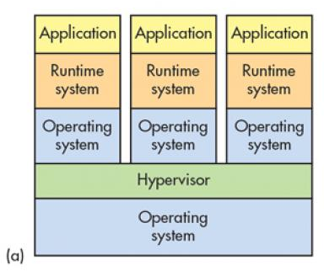
Complexity of Virtual Machines
Notes:
Hypervisor is the culmination of hardware,software,and firmware for deploying and managing virtual machines
Type 1: The entire host operating system is dedicated to running virtual machines
Type 2: Normal user application like Virtual Box

Slide 6
Introducing Containers!
Contained environment where you can deploy applications without all the bloat of a virtual machine
Expectation that the application will run the same regardless of the underlying OS
Sorta like VMs in that they are clonable, scalable, and provide a level of isolation
Unlike VMs, they have a very small resource footprint, averaging between tens and hundreds of megabytes in both storage and ram
Relies heavily on host operating system features so it’s quick to launch and takes up very little space
Services like Docker allow you to define the entire operating system in a static file

Slide 7
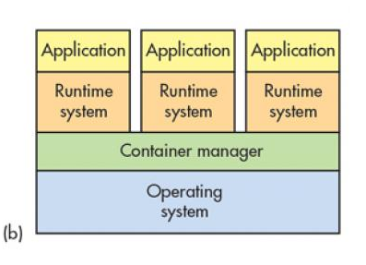
Complexity of Containers

Slide 8
What is this magic?
Containers are made up of multiple components:
Cgroups: collection of processes bound to a set resource limit
Namespaces: Isolated resource pools that are limited in what they have access to
Copy-on-write storage: type of storage where data is shared up until the point it is modified. Right before the data is modified, that data is copied to its location.
Other tidbits dealing with security and privileges such as SELinux and Apparmor
Tl;dr
Cgroups: Limits amount of resources you have
Namespaces: Limits what you have access to
Copy-on-write: Super efficient way of dealing with lots of data

Slide 9
Cgroups
Initially mainlined into Linux Kernel version 2.6.24
A collection of processes that are bound by the same criteria and associated with a set of parameters or limits.
Has multiple features:
Resource limiting: Limit memory usage, file system cache
Prioritization: Set shares of CPU utilization or disk I/O
Accounting: measure a group’s utilization, which is useful for logging utilities and billing purposes
Control: Freeze control groups, migrate them, and restart

Slide 10
Namespaces
Namespaces partition kernel resources in a way that a one processes sees a different set of resources than another.
Multiple kinds:
Mount (mnt) - namespaces for mount points. Allows you to define root partition in a container. In the parent process the FS might look something like /var/lib/docker/volumes/container_ID/somefolder whereas in the child process, the FS looks like /somefolder.
Process ID (pid) - separates out processes into their own process trees. A parent process namespace might be able to see child processes in the child process tree, but the child can’t see parent’s root process node.
Network (net) - allows for virtual network stack. Each namespace can have it’s own interfaces, routing tables, firewall rules, etc.
UTS - allow for a single system to have multiple host and domain names for different processes
User - namespaces that isolate privileges and UIDs across processes. For example, the root user on a Linux system always has a UID of 0. You can be root on a container with a PID of 0 while not having a PID of 0 on the host system. Instead, it maps to a non-privileged UID.

Slide 11
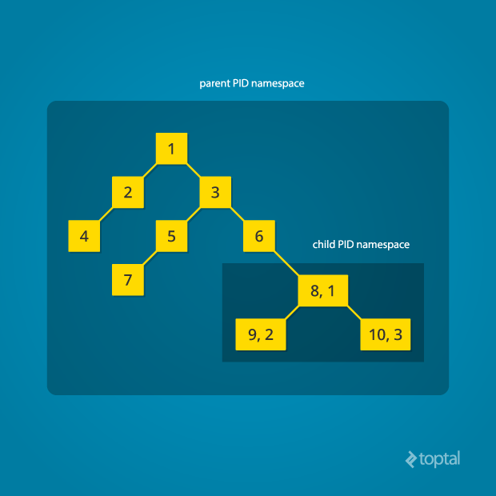
PID Namespace Example

Slide 12
Copy-on-write Storage
Copy-on-write storage: type of storage where data is shared up until the point it is modified. Right before the data is modified, that data is copied to its location.
Works similarly to Rsync, were only changes are copied
Makes deploying new containers extremely fast

Slide 13
Is it secure tho?!
Much more secure than running code uncontained
Namespace separation helps prevent attackers from accessing files and processes they shouldn’t have access to.
Kernel security modules such as AppArmor and SELinux can further restrict the access of a compromised container. Apparmor and SELinux can restrict the actions you can do within a compromised container.
Ultimately, the biggest issue is misconfiguration
Check out https://github.com/ProfessionallyEvil/Pequod for some container hacking fun.

Slide 14
Apparmor Nginx Example
https://docs.docker.com/engine/security/apparmor/#resources-for-writing-profiles

Slide 15
Container From Scratch
https://ericchiang.github.io/post/containers-from-scratch/

Slide 16
Docker Examples
docker pull imagesname:version - downloads a docker image
docker build . -t containername - builds a local Dockerfile
docker run imagename - runs an image with default configurations
docker run imagename -p 127.0.0.1:8080:80 - runs an image with port 80 bound to localhost 127.0.0.1
docker exec -it container_name /bin/bash

